Slide 1
Exercise: Version Control, Build Automation, and Mocking
Software Testing and Maintenance Anumeet Nepaul

Slide 2
Version Control System
“Version control is a system that records changes to a file or set of files over time so that you can recall specific versions later.”
Helps maintain code
Keeps a history of the changes
Can allow over simultaneous code editing
Examples
Git
SVN

Slide 3
Git
Distributed VCS
Allows users to have local version (on personal computers) and remote version of code (on servers)
Was developed by the open source community to track the Linux OS development

Slide 4
Git Workflow
Copies (CLONE) server files to local computer
Command: git clone user@domain.com:Group/Project
Start your own versioning history (BRANCH)
Command: git checkout –b branch-name
Saves (COMMIT) snapshots of the project locally
Command: git commit –m “Commit Message”
Update (PULL) local snapshots of the project from server
Command: git pull
Send (PUSH) local updates to the server
Command: git push
Git tutorials at:
https://www.atlassian.com/git/tutorials/setting-up-a-repository

Slide 5
Build Automation
Automates the process of creating executable or archive files from source code for faster distribution
Removes the need for one person who know the build system to manually build it for each developer and tester
Run complicated tasks easily
Repeatability of tasks
Helps document the tasks

Slide 6
Gradle
Similar to other build systems
For example, Ant and Maven
Concise build files written in Groovy
And looks similar to Java
Also plugins remove lot of boiler plate code
Dependency Management
Declare jars the project needs and Gradle will download it from online repositories
Default build system for Android programming

Slide 7
Gradle Build File
Plugins
Add base functionality to your project build file
Code: apply plugin: ‘java’
Repositories
Defines where the build files should look for dependencies
Code: repositories { mavenCentral() }
Looks for jars at https://search.maven.org
Dependencies
Defines jars needed to build java project
Code: compile 'com.google.guava:guava:21.0’
Gradle tutorials at:
https://gradle.org/docs#getting-started

Slide 8
Mocking Frameworks
Used to fool tests into thinking we are using real dependencies, while we “mock” them
For example, imagine we are testing Door class
The Door class dependencies
Door => Wall => House => …
To test specific behavior of Door class
We have to build specific Door objects
Each specific Door object needs to specific Wall object
Each Wall object needs House objects
…

Slide 9
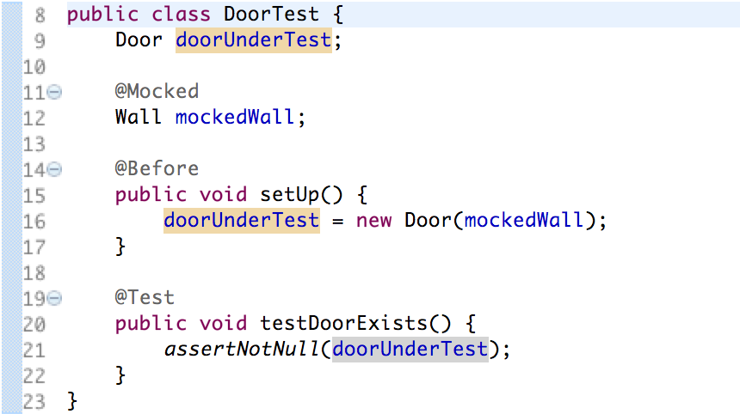
Mocking Framework
Solution
Attach REAL Door object to MOCKED Wall object

Slide 10
JMockit
Mocking framework for java
Uses Java annotations and objects to configure mocks
Mocked objects can specific behavior
Mocked objects can be tested to make sure specific methods were called with certain parameter
JMockit tutorial at:
http://jmockit.org/gettingStarted.html

Slide 11
Creating a Mocked object
Add the @Mocked annotation to a interface type
Automatically injects mocked object at run time

Slide 12
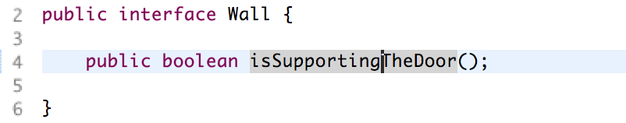
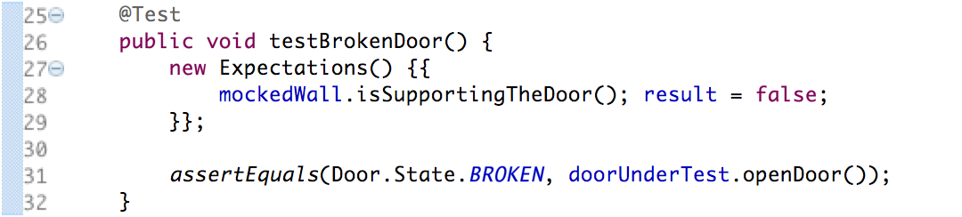
Recording Expectation
Records specific behavior for mocked objects
In other words, makes mocked objects behave in the way you want.
Methods in Wall interface
Recording implementation with interface
This Expectation says that when Wall.isSupportingTheDoor is called the result is false
Notice double curly braces with new Expectation object

Slide 13
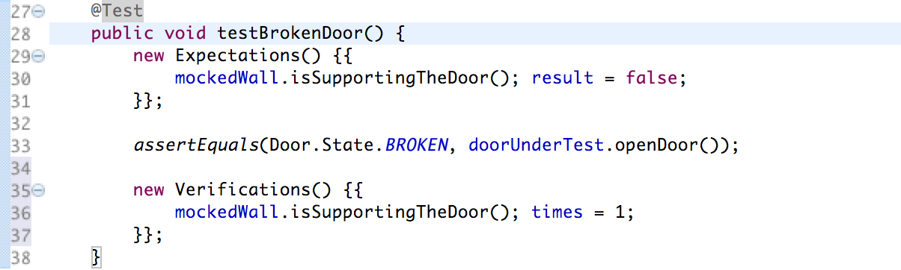
Verifications
After mocked behavior is recorded and the test has run through
We can test how what methods were called in the mocked object to ensure correct behavior
Verification object ensures Wall.isSupportingTheDoor is called only once
Again two curly braces

